Slide 1
Course Code: EEE 4101
Course Title: Electrical Engineering
Keyboard shortcut for,
A_{subscript} : Ctrl + =
A^{superscript} : Ctrl + Shift + =
Course Teacher: Sadia Enam
Lecturer (EEE),
Dept. of ICT, BDU
Ref. Book: Fundamental of Electrical Circuit: Alexander Sadiku

Slide 2
Circuit Theorem
A major advantage of analyzing circuits using Kirchhoff’s laws is that we can analyze a circuit without tampering with its original configuration.
A major disadvantage of this approach is that, for a large, complex circuit, tedious computation is involved.
The growth in areas of application of electric circuits has led to an evolution from simple to complex circuits. To handle the complexity, engineers over the years have developed some theorems to simplify circuit analysis. Such theorems include Thevenin’s and Norton’s theorems.

Slide 3




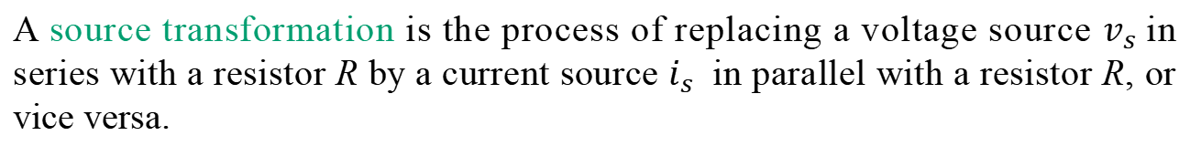
Source Transformation
A source transformation is the process of replacing a voltage source $v_{s}$in series with a resistor R by a current source $i_{s}$ in parallel with a resistor R, or vice versa.

Slide 4




















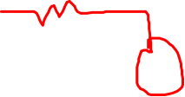




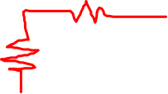

Source Transformation (Contd.)
Q. Use source transformation to find $v_{o}$ in the following circuit.

Slide 5






















Superposition Theorem
If there is short circuit in parallel with a resistor, then current won’t go through the resistor
The superposition principle states that the voltage across (or current through) an element in a linear circuit is the algebraic sum of the voltages across (or currents through) that element due to each independent source acting alone.
Q. Use the superposition theorem to find v in the given circuit.

Slide 6
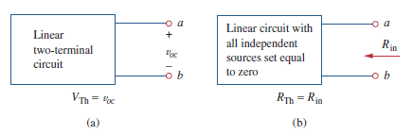
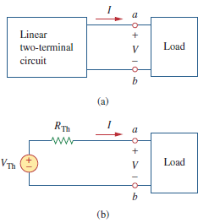

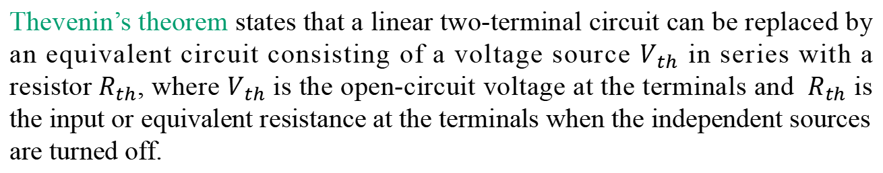
Thevenin’s Theorem
to find R_{th}
Dependant sources cannot be turned off. Keeping it on , while the independant sources are turned off, you need to add a voltage source of some voltage (1 V for simplicity); (or a cuurent source of some ampere i.e. 1 A; or even unspecified values of V₀ and I₀
Thevenin’s theorem states that a linear two-terminal circuit can be replaced by an equivalent circuit consisting of a voltage source $V_{th}$ in series with a resistor${ R}_{th}$, where $V_{th}$ is the open-circuit voltage at the terminals and ${ R}_{th}$ is the input or equivalent resistance at the terminals when the independent sources are turned off.
If there is no Dependent (voltage / current) source, then automatically V_{Th} = 0;

Slide 7
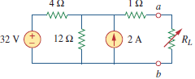











































Thevenin’s Theorem (Cond.)
Q. Find the Thevenin equivalent circuit of the circuit shown below, to the left of the terminals a-b. Then find the current through $R_{L}=6 Ω, 16 Ω, 36 Ω$
Thevenin equivalent circuit
as there’s an open circuit, current won’t flow through 1 ohm

Slide 8
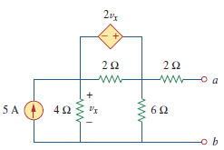




















Thevenin’s Theorem (Cond.)
Q. Find the Thevenin equivalent of the circuit in the following figure at terminals a-b.
note: No cuurent will flow through this 2 ohm as there is an open circuit at terminal a and b

Slide 9
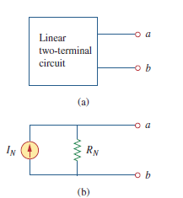



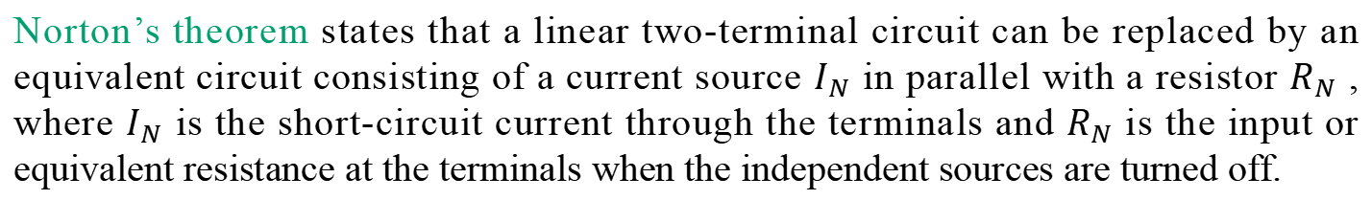
Norton’s Theorem
If there is short circuit in parallel with a resistor, then current won’t go through the resistor
Norton’s theorem states that a linear two-terminal circuit can be replaced by an equivalent circuit consisting of a current source $I_{N}$ in parallel with a resistor $R_{N}$ , where $I_{N}$ is the short-circuit current through the terminals and $R_{N}$ is the input or equivalent resistance at the terminals when the independent sources are turned off.
Proccess of getting R_{Th} and R_{N} are the same

Slide 10
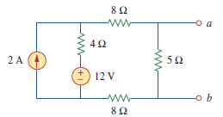



















Norton’s Theorem (Contd.)
If there is short circuit in parallel with a resistor, then current won’t go through the resistor
Q. Find the Norton equivalent circuit of the circuit in the following figure at terminals a-b.
as no current will flow through 5 ohm

Slide 11
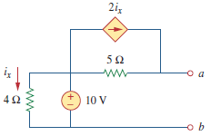





Norton’s Theorem (Contd.)
If there is short circuit in parallel with a resistor, then current won’t go through the resistor
Q. Using Norton’s theorem, find $R_{N}$ and $I_{N}$ of the circuit in the given figure at terminals a-b.

Slide 12
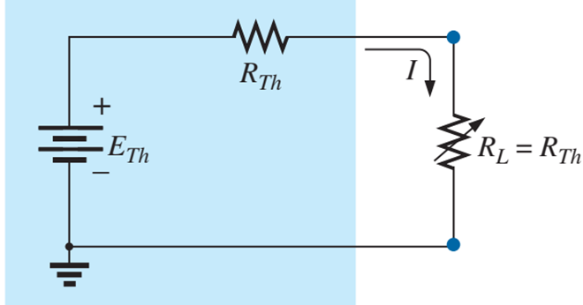















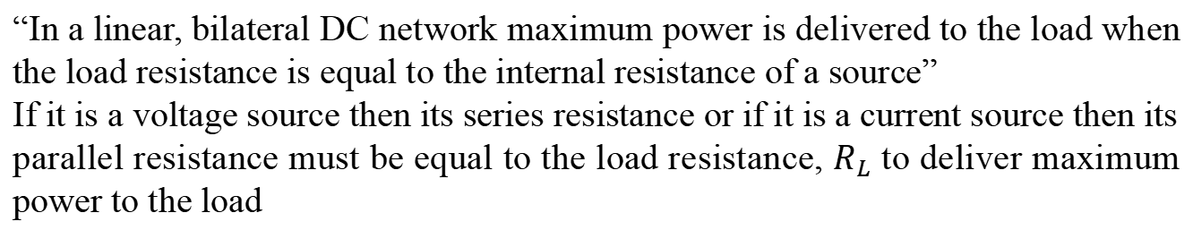
Maximum Power Transfer Theorem
“In a linear, bilateral DC network maximum power is delivered to the load when the load resistance is equal to the internal resistance of a source”
If it is a voltage source then its series resistance or if it is a current source then its parallel resistance must be equal to the load resistance, $R_{L}$ to deliver maximum power to the load

Slide 13
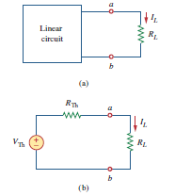
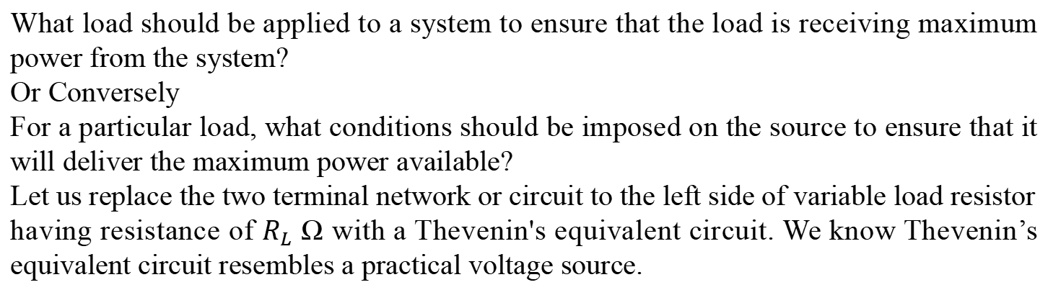
Maximum Power Transfer Theorem (Contd.)
What load should be applied to a system to ensure that the load is receiving maximum power from the system?
Or Conversely
For a particular load, what conditions should be imposed on the source to ensure that it will deliver the maximum power available?
Let us replace the two terminal network or circuit to the left side of variable load resistor having resistance of $R_{L}$ Ω with a Thevenin's equivalent circuit. We know Thevenin’s equivalent circuit resembles a practical voltage source.
ans.: the value of R_{Th} or R_{N}
ans.: ???

Slide 14

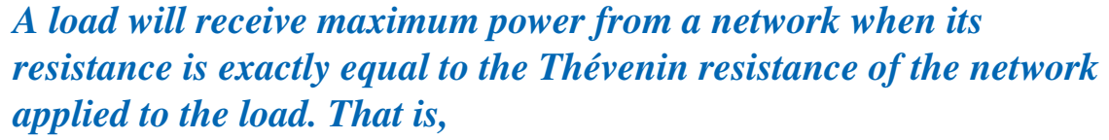











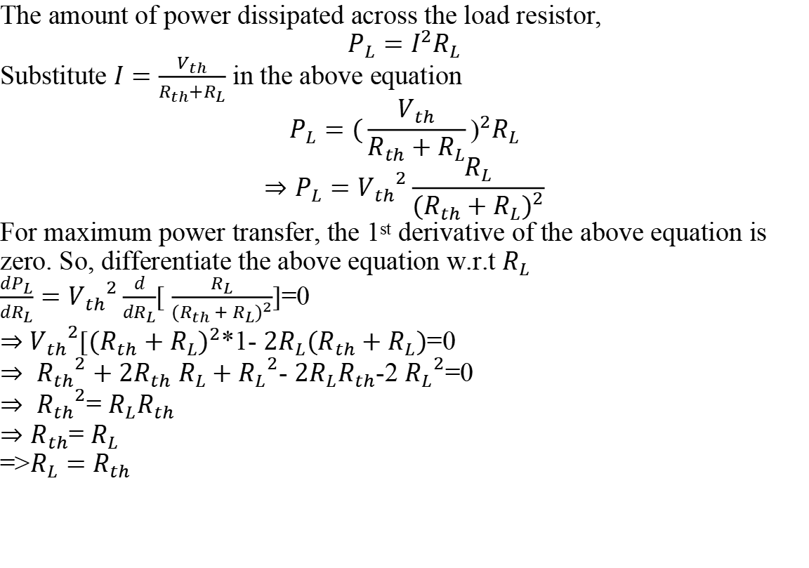
Maximum Power Transfer Theorem (Contd.)
The amount of power dissipated across the load resistor,
$$P_{L}=I^{2}R_{L}$$
Substitute $I=\frac{V_{th}}{R_{th}+R_{L}}$ in the above equation
$$P_{L}={(\frac{V_{th}}{R_{th}+R_{L}}\text{)}}^{2}R_{L}$$
$$⇒P_{L}={V_{th}}^{2}\frac{R_{L}}{{{(R}_{th}+R_{L})}^{2}}$$
For maximum power transfer, the 1st derivative of the above equation is zero. So, differentiate the above equation w.r.t $R_{L}$
$\frac{dP_{L}}{dR_{L}}={V_{th}}^{2}\frac{d}{dR_{L}}$[ $\frac{R_{L}}{{{(R}_{th}+R_{L})}^{2}}$]=0
$⇒$ ${V_{th}}^{2}$[${{(R}_{th}+R_{L})}^{2}$*1- ${2R_{L}(R}_{th}+R_{L})$=0
$⇒ {R_{th}}^{2}+2R_{th}$ $R_{L}+{R_{L}}^{2}$- ${2R_{L}R}_{th}$-2 ${R_{L}}^{2}$=0
$⇒ {R_{th}}^{2}$= ${R_{L}R}_{th}$
$⇒R_{th}$= $R_{L}$
=>$R_{L}=$ $R_{th}$
P_{L} = I * (V_{th} R_{L} / (R_{L} + R_{th}) )
= (V_{th} / (R_{L} + R_{th}) ) * (V_{th} R_{L} / (R_{L} + R_{th}) )
= (V_{th} / (R_{L} + R_{th}) ⁾² * R_{L}
with respect to
$R_{L}=$ $R_{th}$

Slide 15




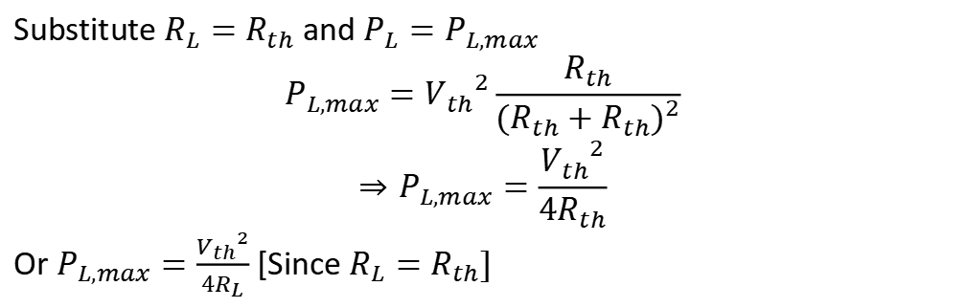
Maximum Power Transfer Theorem (Contd.)
Substitute $R_{L}=$ $R_{th}$ and $P_{L}=P_{L,max}$
$$P_{L,max}={V_{th}}^{2}\frac{R_{th}}{{{(R}_{th}+R_{th})}^{2}}$$
$$⇒P_{L,max}=\frac{{V_{th}}^{2}}{4R_{th}}$$
Or $P_{L,max}=\frac{{V_{th}}^{2}}{4R_{L}}$ [Since $R_{L}=$ $R_{th}]$

Slide 16
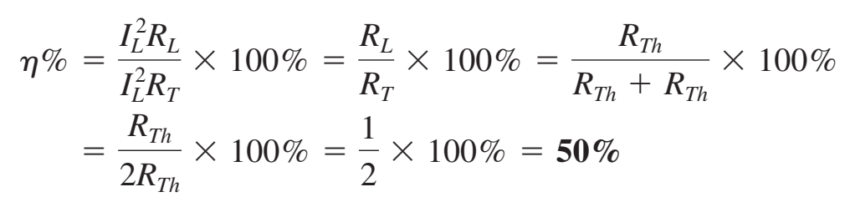



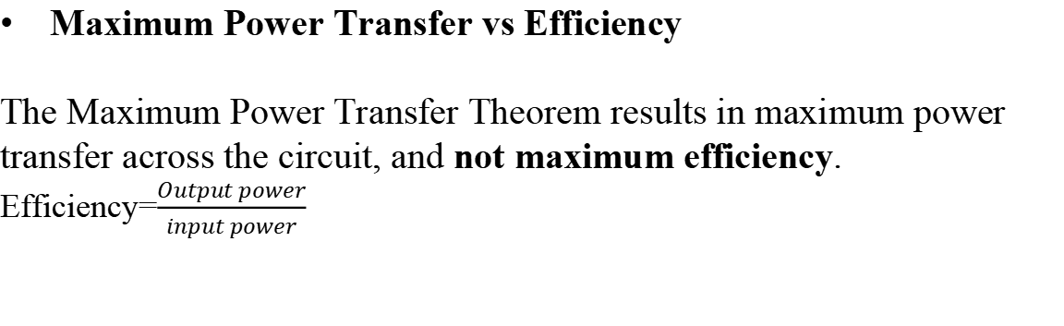
Maximum Power Transfer Theorem (Contd.)
Maximum Power Transfer vs Efficiency
The Maximum Power Transfer Theorem results in maximum power transfer across the circuit, and not maximum efficiency.
Efficiency=$\frac{Output power}{input power}$
otal
otal
Application: In car engines, the power delivered to the starter motor of the car will depend upon the effective resistance of the motor and the internal resistance of the battery. If the two resistances are equal, maximum power will be transferred to the motor to turn to the engine.

Slide 17
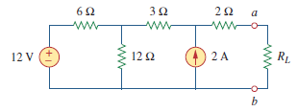








































































Maximum Power Transfer Theorem (Contd.)
Q. Find the value of for maximum power transfer in the circuit of following circuits. Find the maximum power.
No current will go through 2 ohm as there’s an open circuit there

Slide 18
Thank You

